Slide 1
Final Project

Slide 2
Introduction

Slide 3
Ideas occurred to us
Game
Graphical User Interface
Encryption

Slide 4
Final Decision
Game
Power Line
Racing
Tanks
Graphical User interface
Tkinter

Slide 5
Final Decision
Game
Power Line (support up to 4 players)
Racing (simple 3-dimentional game)
Tanks (support two players)
Graphical User interface
Tkinter

Slide 6
Game Demo and Analysis

Slide 7
Game No.1 - Power Line

Slide 8
Game No.2 - Racing

Slide 9
Game No.3 - Tanks

Slide 10
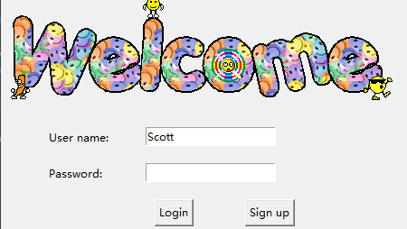
GUI Tkinter (Please use GitHub)

Slide 11
GUI Chatting Interface

Slide 12
State Machine
S_OFFLINE = 0 S_CONNECTED = 1 S_LOGGEDIN = 2 S_CHATTING = 3 S_REQUEST = 4 S_GAMEMENU = 5 S_POWERLINE = 6 S_RACING = 7 S_TANKS = 8

